Slide 1

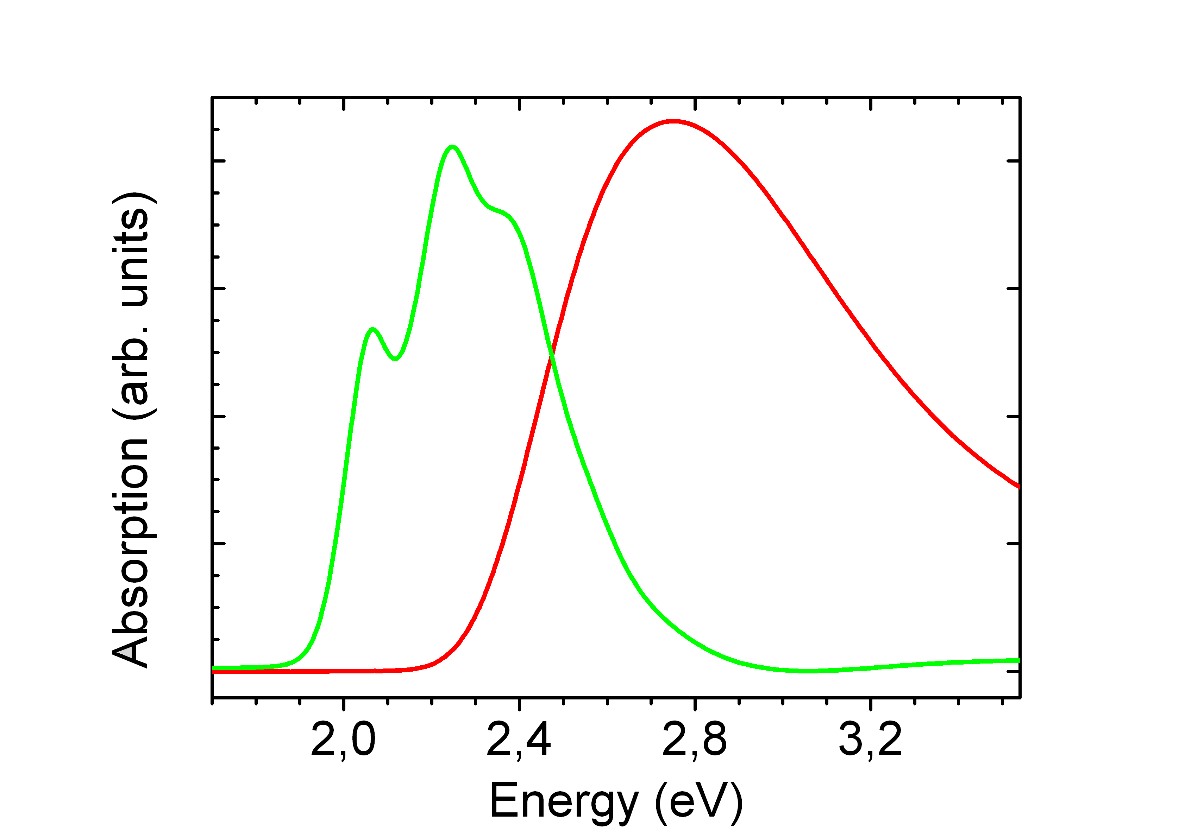
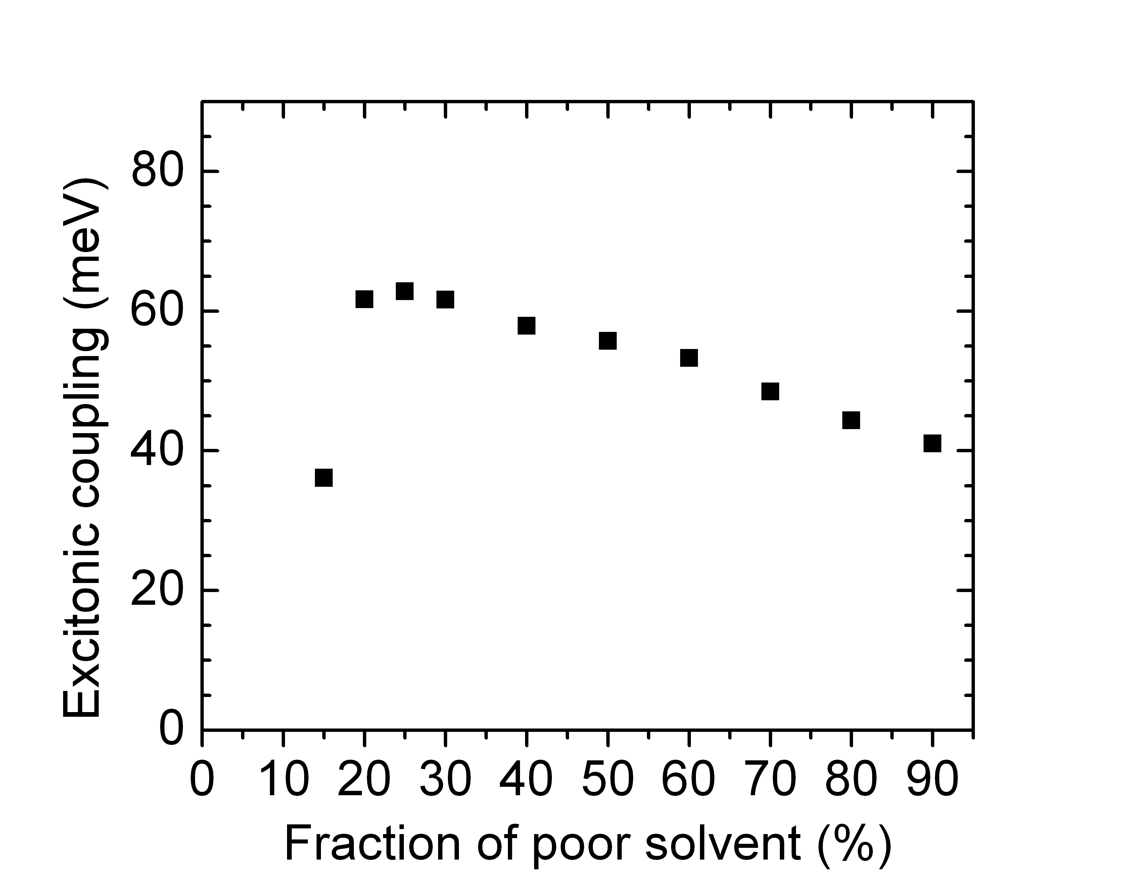
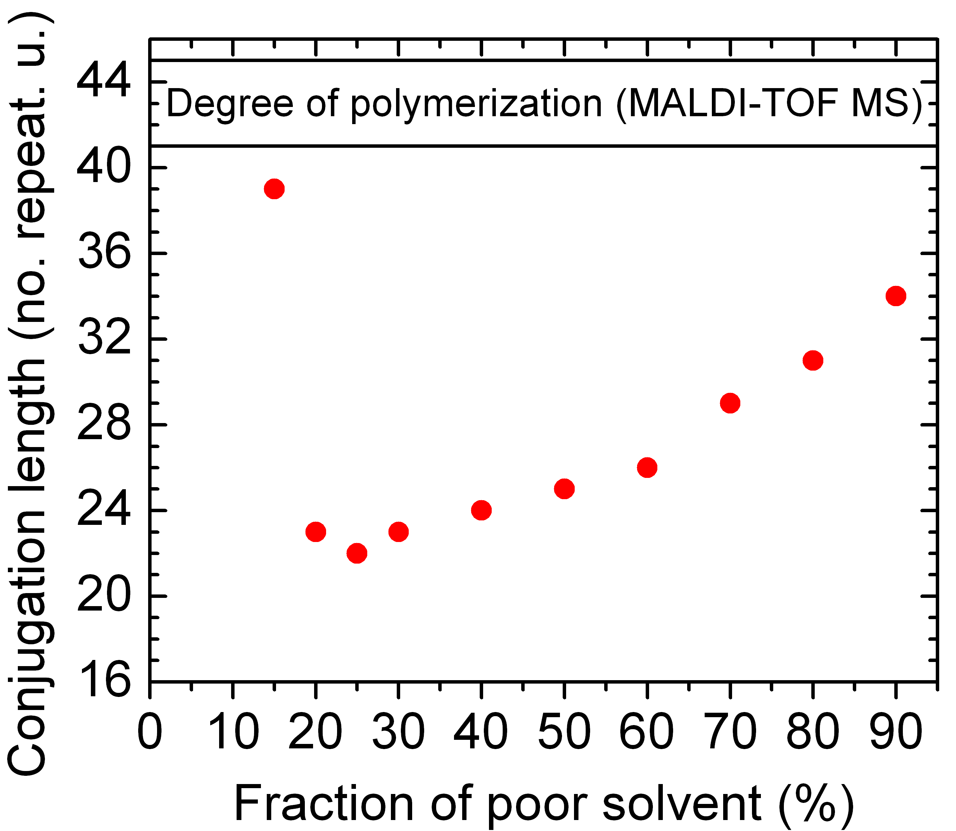
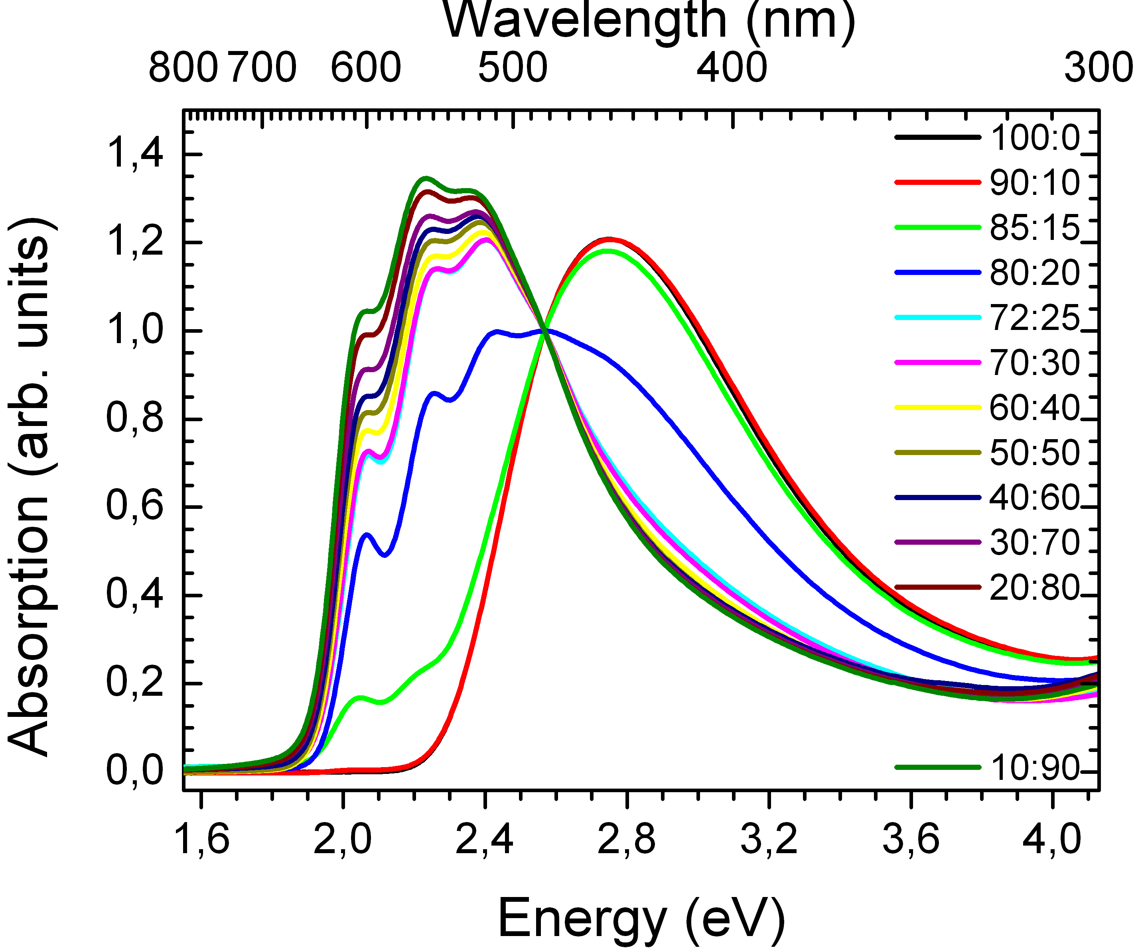
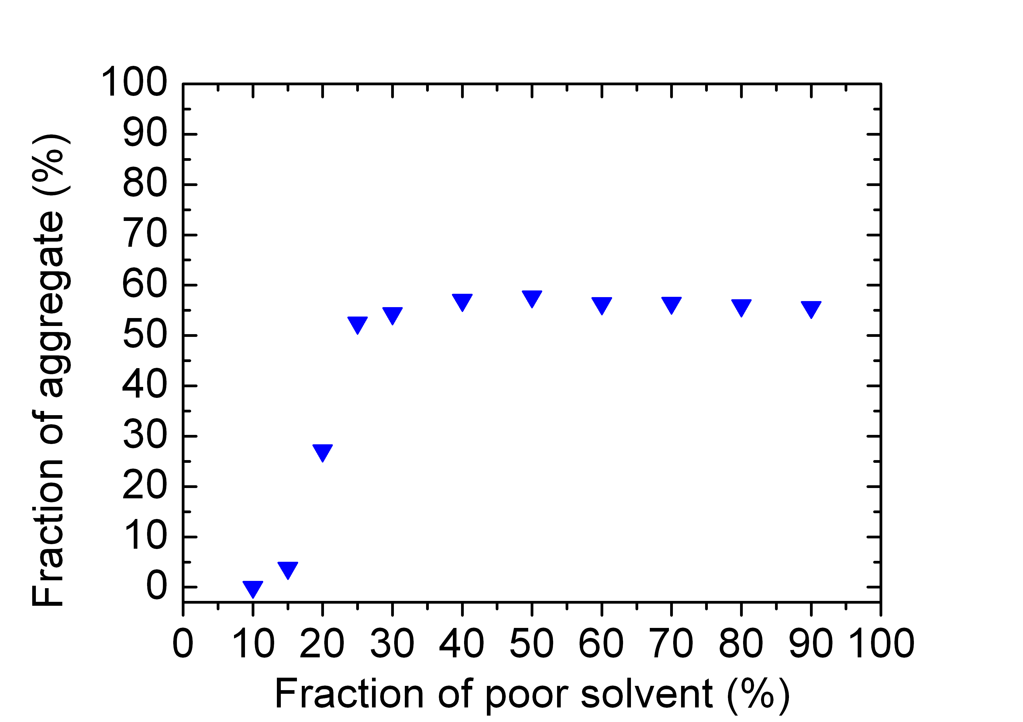
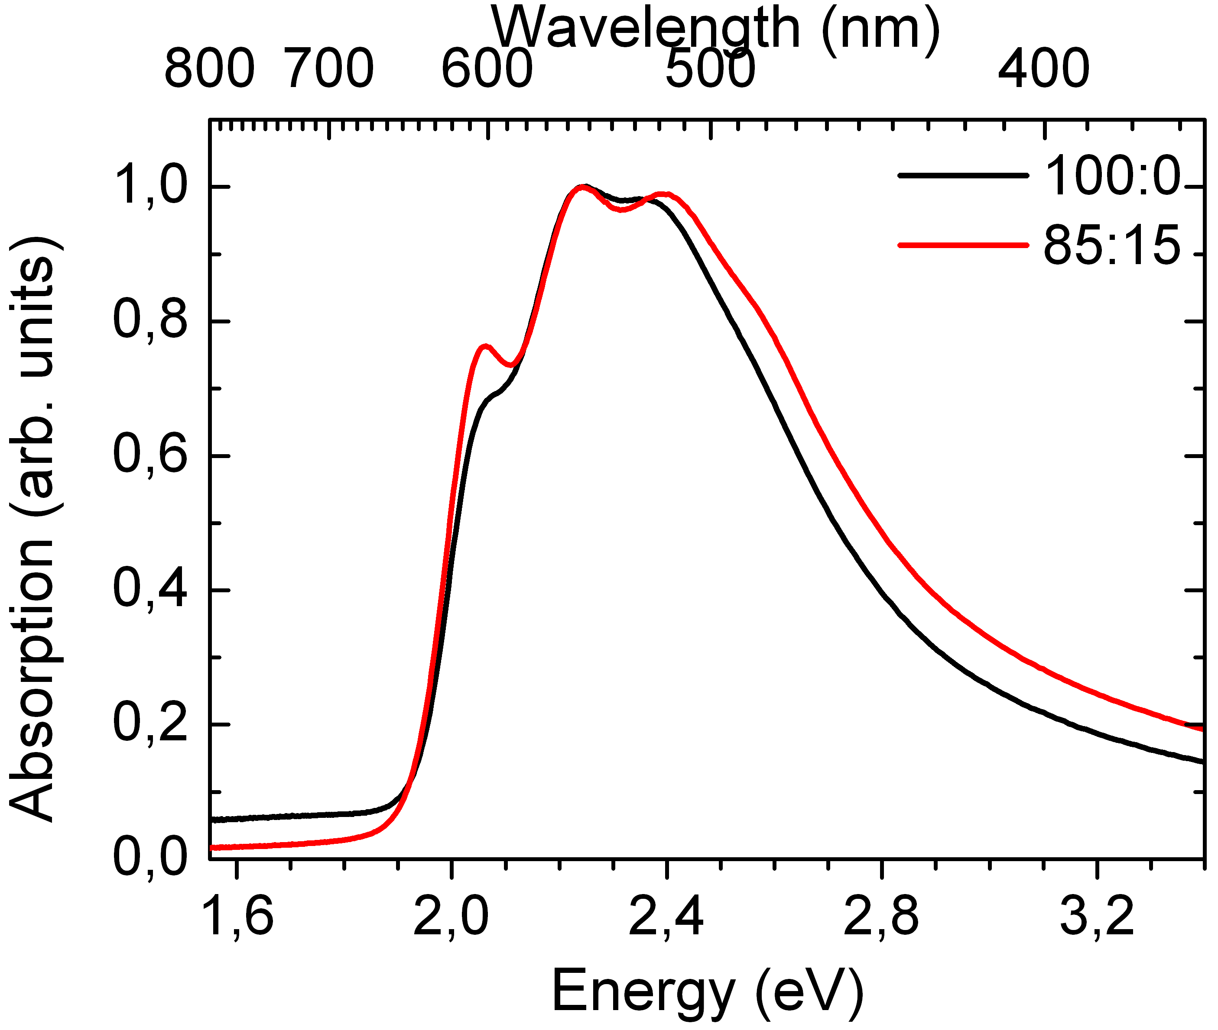
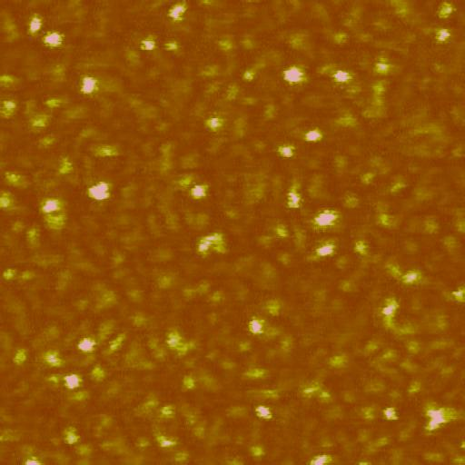
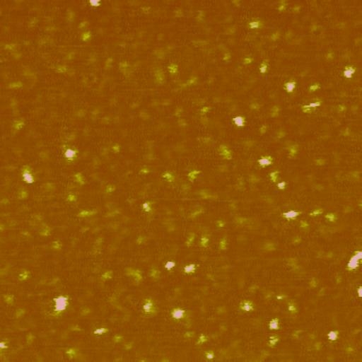
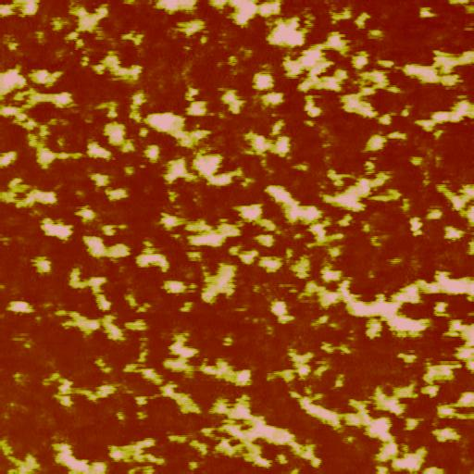
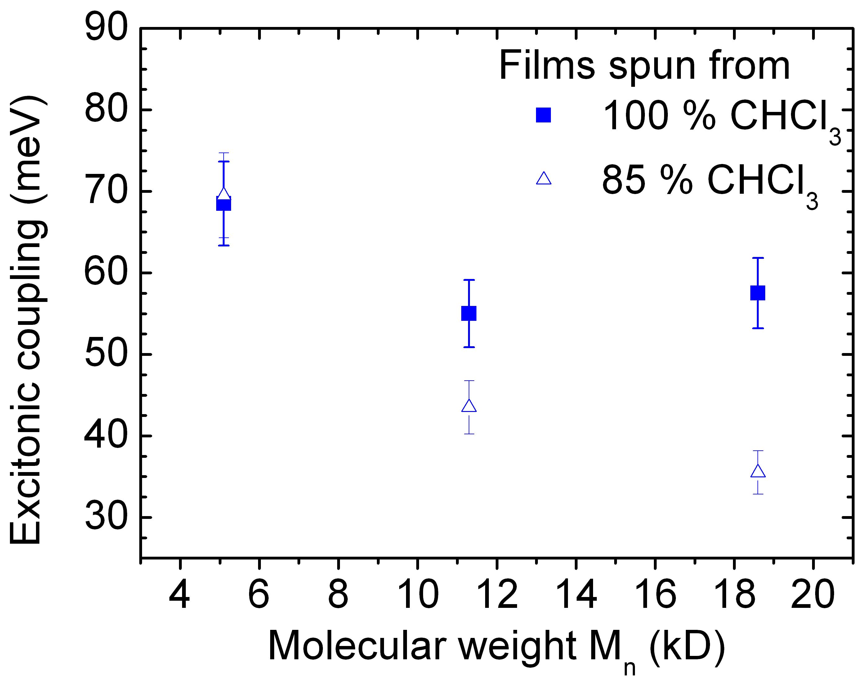
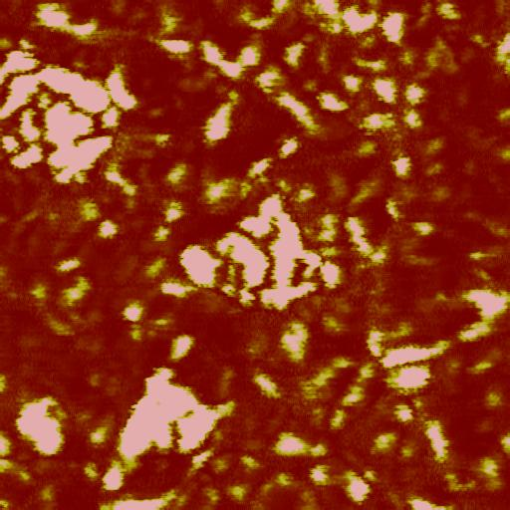
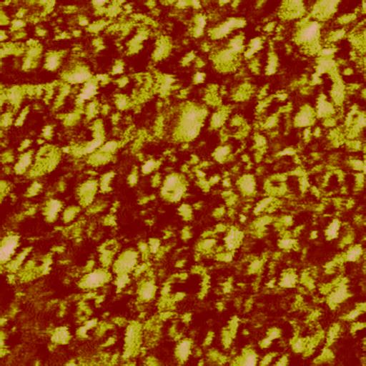
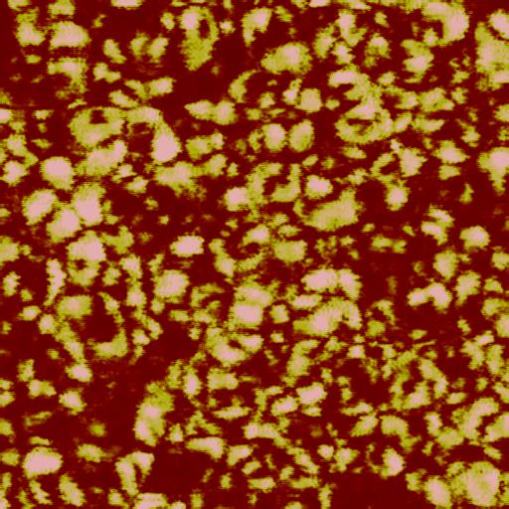
Control of aggregates in poly(3-hexylthiophene) solutions and thin films
Christina Scharsich, Anna Köhler, Department of Physics, University of Bayreuth, Bayreuth, Germany
Ruth Lohwasser, Mukundan Thelakkat, Department of Chemistry, University of Bayreuth, Bayreuth, Germany
Motivation
Approach
Recent research has shown that the charge
carrier mobility in poly(3-hexylthiophene)
(P3HT) depends not only on the molecular
weight, but also on the nature of the
aggregates formed during film preparation.
This was attributed to differences in aggregate morphology and differences in the intermolecular coupling that exists in weakly aggregated P3HT chains.
In order to understand and control the nature of P3HT aggregates, we characterize different aggregates in solution by determining the
excitonic coupling and the resulting conjugation length.
Transistors are spun from solution. In solution, P3HT is known to adopt two different conformations:
regioregular P3HT
aggregated chains,
long conjugation length
dissolved chains,
short conjugation length
We control the aggregates in solution by changing the quality of the solvent.
These aggregates act as starting points for aggregate formation in films!
Aggregates in solutions
Conjugation length via
line-dipole model^{[2]}:
A₂
11.3 kD
Excitonic coupling^{[1]}:
A₁
100:0
long chromophore
weak coupling
Coupling strength depends
on solvent quality!
short chromophore
strong coupling
100:0
Fraction of aggregates in solution
Conjugation length within the aggregates increases
with decreasing solvent quality after reaching the
constant value of 50% - 60% of aggregated chains!
P3HT solutions with ratio of good : poor solvent (CHCl₃:EtAc), all at the same concentration.
poor solvent → more aggregation
A₁/A₂ ratios → different excitonic coupling^{[1]}
→ different conjugation length^{[2]}
→ different nature of aggregates
Packing behavior of the P3HT chains within the aggregates:
Aggregated fraction does not
exceed a limit of 50% - 60%!
Some chains or chain ends are
still dissolved!
^{[1]} F. C. Spano, J. Chem. Phys. 122 (2005) 23
^{[2]} J. Gierschner et al., J. Chem. Phys. 130 (2009) 6
25:75
10:90
Decreasing solvent quality
Aggregates in Films
A₂
Absorption shows
increasing ratio A₁/A₂ with
addition of poor solvent.
Excitonic coupling gets
weaker!
Conjugation length within
aggregates gets longer!
Packing behavior within aggregates:
P3HT films were spun from solutions containing pre-aggregates; solutions with ratio of CHCl₃:EtAc.
A₁
11.3 kD
5.1 kD
M_{n}:
PDI:
5.1 kD
1.22
11.3 kD
1.11
18.6 kD
1.16
Decreasing solvent quality
100:0
11.3 kD
more
aggregates
range of excitonic coupling
in solution
Decreasing solvent quality
85:15
Similar excitonic couplings
in films and solution !!!
18.6 kD
1.5 µm
AFM phase images
Conclusion
Thus, we can transfer the structure of the pre-assembled aggregates into the film structure. We could show that the control over the aggregation in solution gives a control over the aggregation in the film.
Simple absorption measurements and the combination of Spano’s and Gierschner’s theoretical studies^{[1,2]} are a powerful tool to investigate the nature and quality of P3HT aggregates in solutions and in films.
P3HT with low polydispersity forms aggregates in solution and in films with similar excitonic couplings. This indicates a similar nature of the aggregates including their packing perfection and conjugation length.

